Slide 1
PART 3 Applying Your Testing Skills

Slide 2
Agenda

Slide 3
III. Foreign-Language Testing
1. Translation Issues
2. Other Issues
3. Configuration and Compatibility Issues
4. How Much Should You Test?

Slide 4
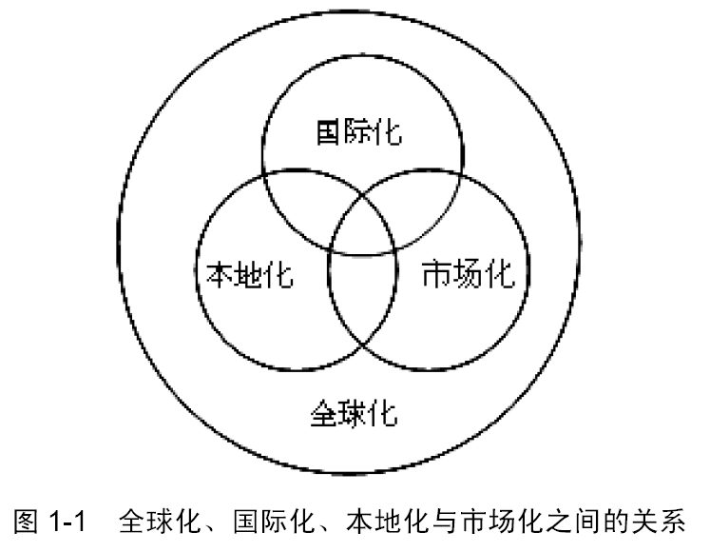

Slide 5
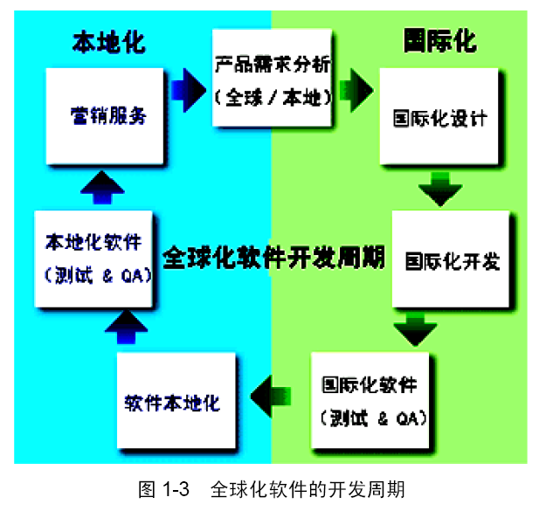

Slide 6
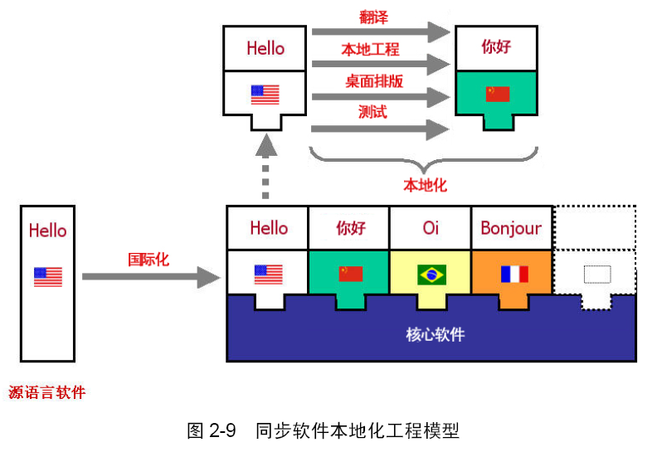
《Developing International Software for Windows 95 and Windows NT》（Microsoft Press，1995年）

Slide 7
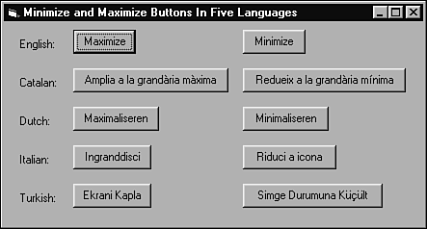
III. Foreign-Language Testing
1. Translation Issues
  Text Expansion
  ASCII, DBCS, and Unicode
  Hot Keys and Shortcuts
  Extended Characters
  Computations on Characters
  Reading Left to Right and Right to Left
  Text in Graphics
  Keep the Text out of the Code

Slide 8
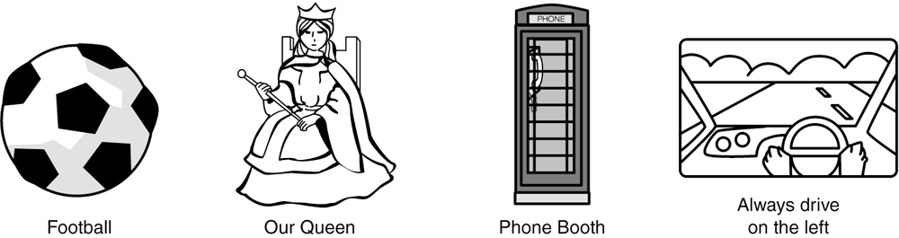
III. Foreign-Language Testing
2. Other Issues
  Content
  Data Formats

Slide 9
III. Foreign-Language Testing
3. Configuration and Compatibility Issues

Slide 10
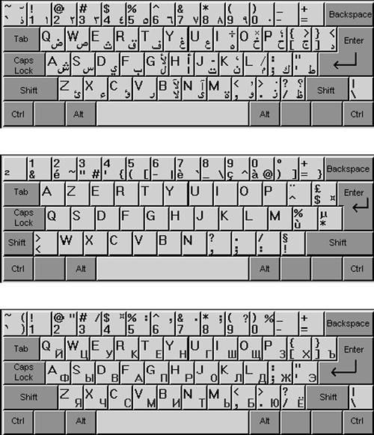

Slide 11
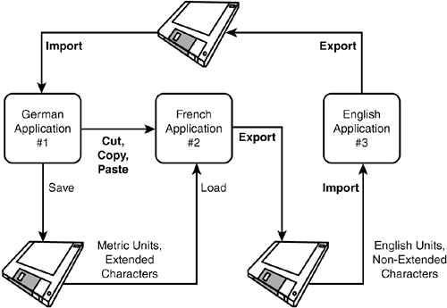

Slide 12
III. Foreign-Language Testing
4. How Much Should You Test?

Slide 13
III. Foreign-Language Testing
1. Translation Issues
2. Other Issues
3. Configuration and Compatibility Issues
4. How Much Should You Test?

